Slide 1
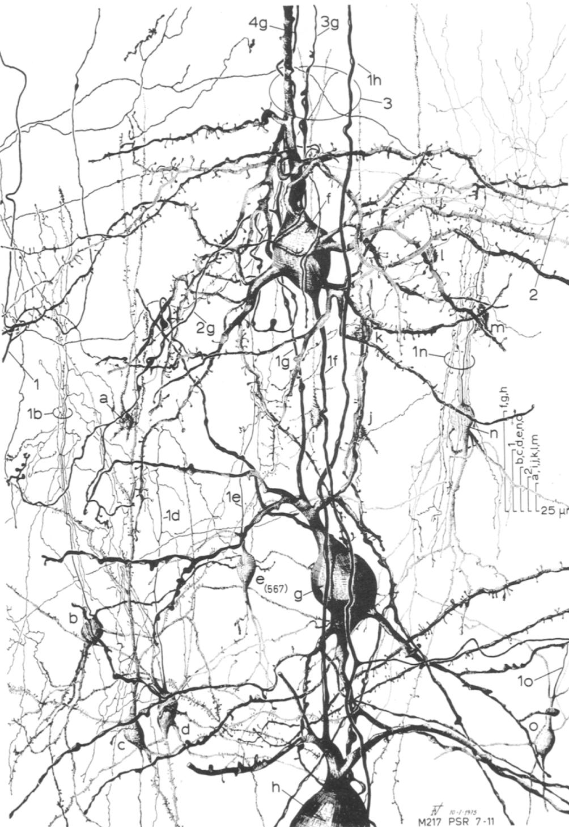
Sensory processing:
Cortical Layers & Cell classes, what are they good for?
Valverde, 1976, J. Neurocytology

Slide 2
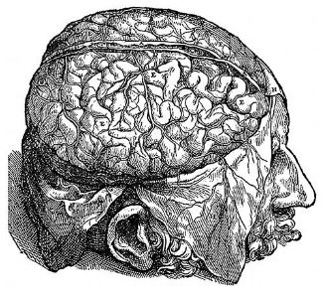
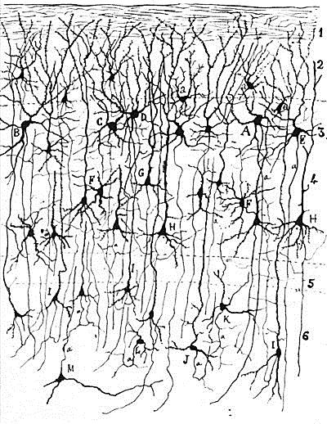
Neocortex
Neocortex
L1
L2
L3
input
network
computations
L4
L5
L6

Slide 3
SOM
VIP
PV
Excitatory
cell
Inhibitory
cell types

Slide 4
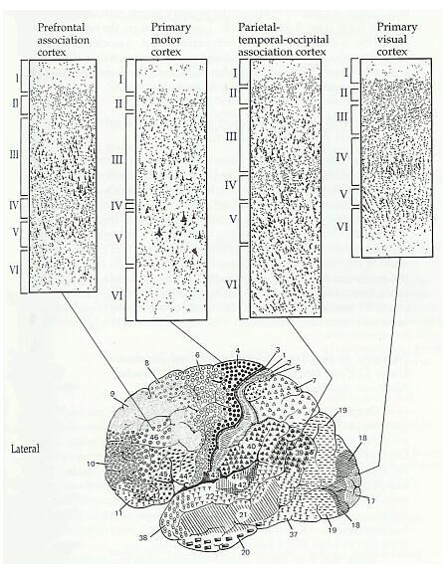
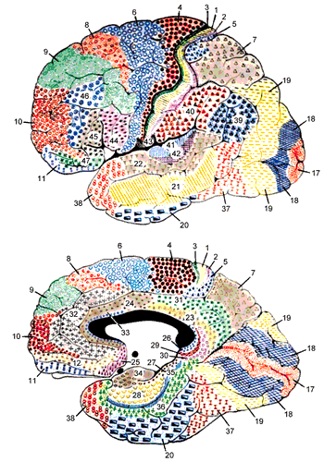
Brodmann Map of Cortical Areas
lateral
medial
44 areas, numbered in order of
samples taken from monkey brain
Brodmann, 1908.

Slide 5
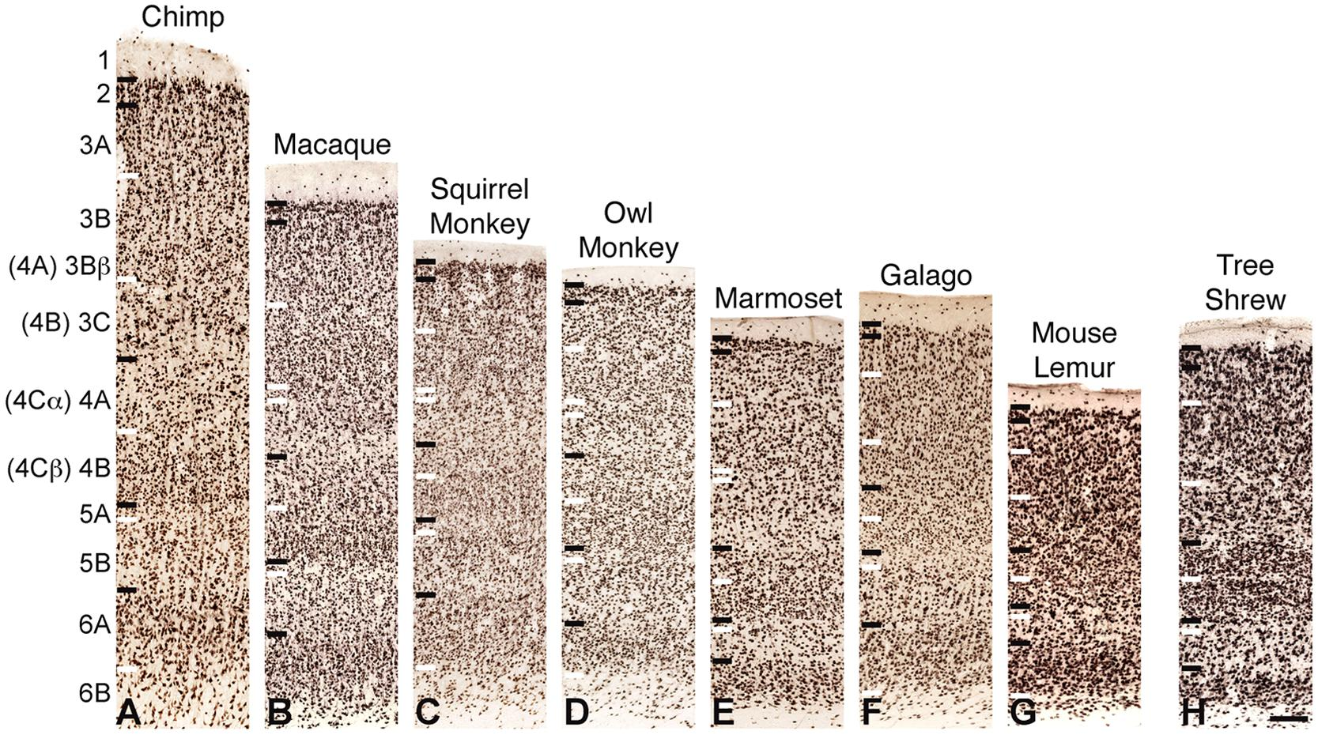
Primary visual cortex lamination across species
Balaram & Kaas 2014 Front Neuroanat

Slide 6
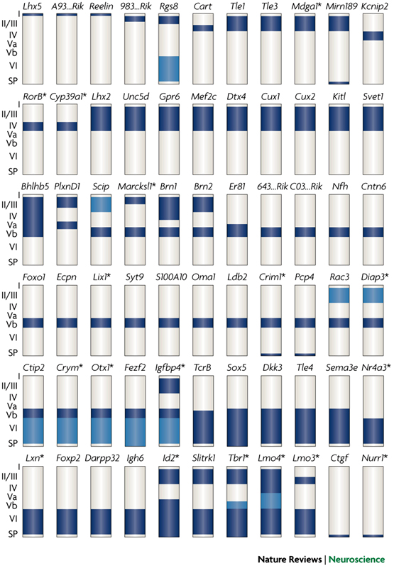
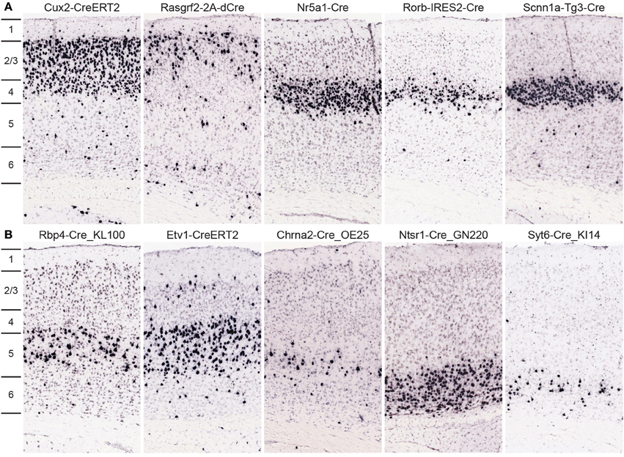
Molecular markers of cortical layers
Harris et al , 2014
Molyneaux et al., 2007
Allen Institute mission: functionally characterise cells in these Cre-lines

Slide 7
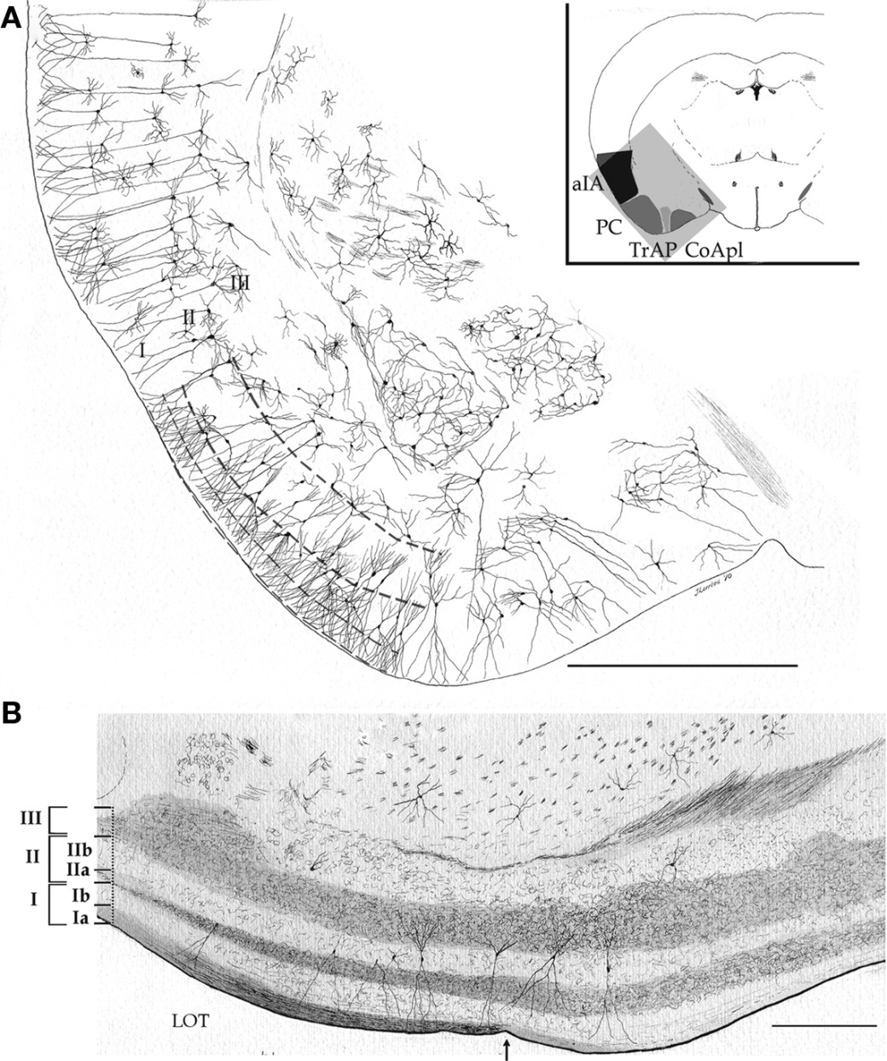
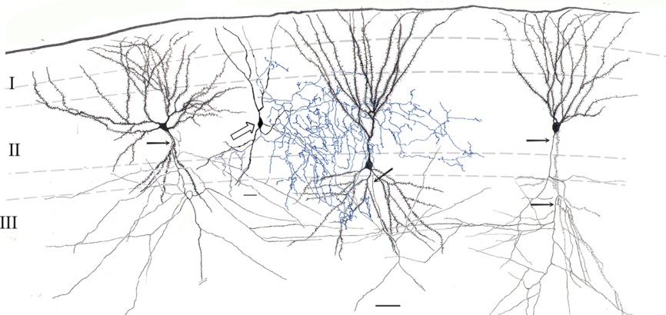
Cortical lamination: not always a six-layered structure (archicortex)
e.g. Piriform, entorhinal
Larriva-Sahd 2010 Front Neuroanat

Slide 8
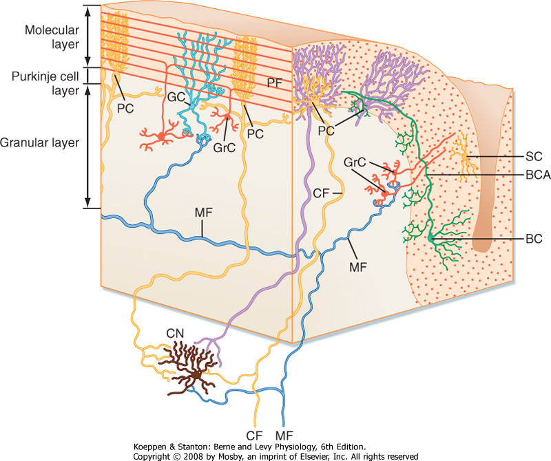
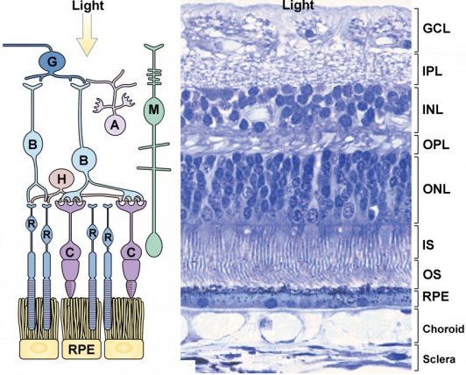
Other layered structures in the brain
Cerebellum
Retina

Slide 9
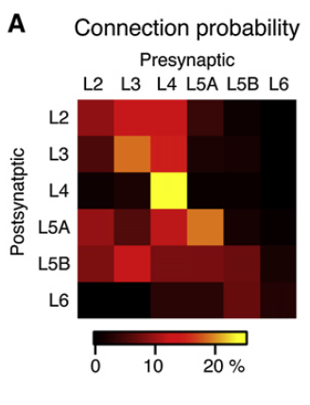
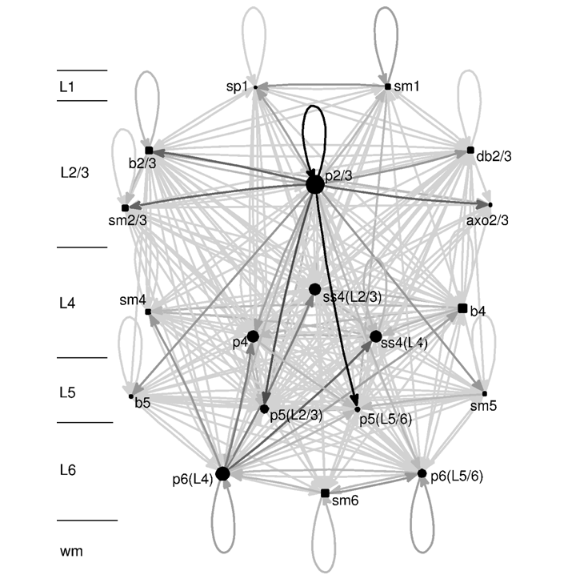
Complexity of connectivity in a cortical column
Paired-recordings and anatomical reconstructions generate statistics of cortical connectivity
Lefort et al. 2009

Slide 10
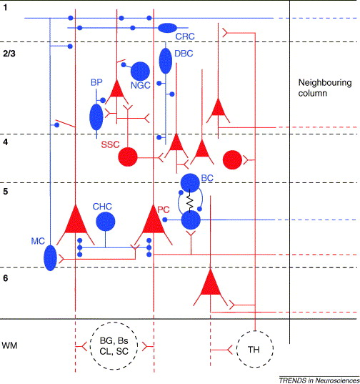
Information flow in neocortical microcircuits
Simplified version
“computational layer”
Layer 2/3
Layer 4
main output
Layer 5
main input
Layer 6
Thalamus
e - excitatory, i - inhibitory
Grillner et al TINS 2005

Slide 11
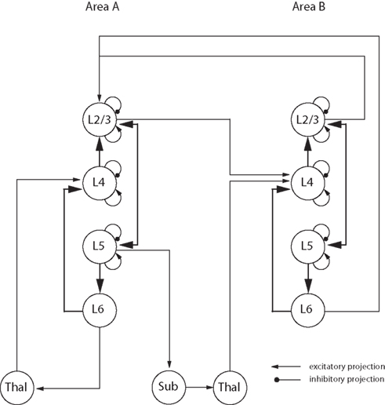
The canonical cortical circuit
MAYBE ….
DaCosta & Martin, 2010

Slide 12
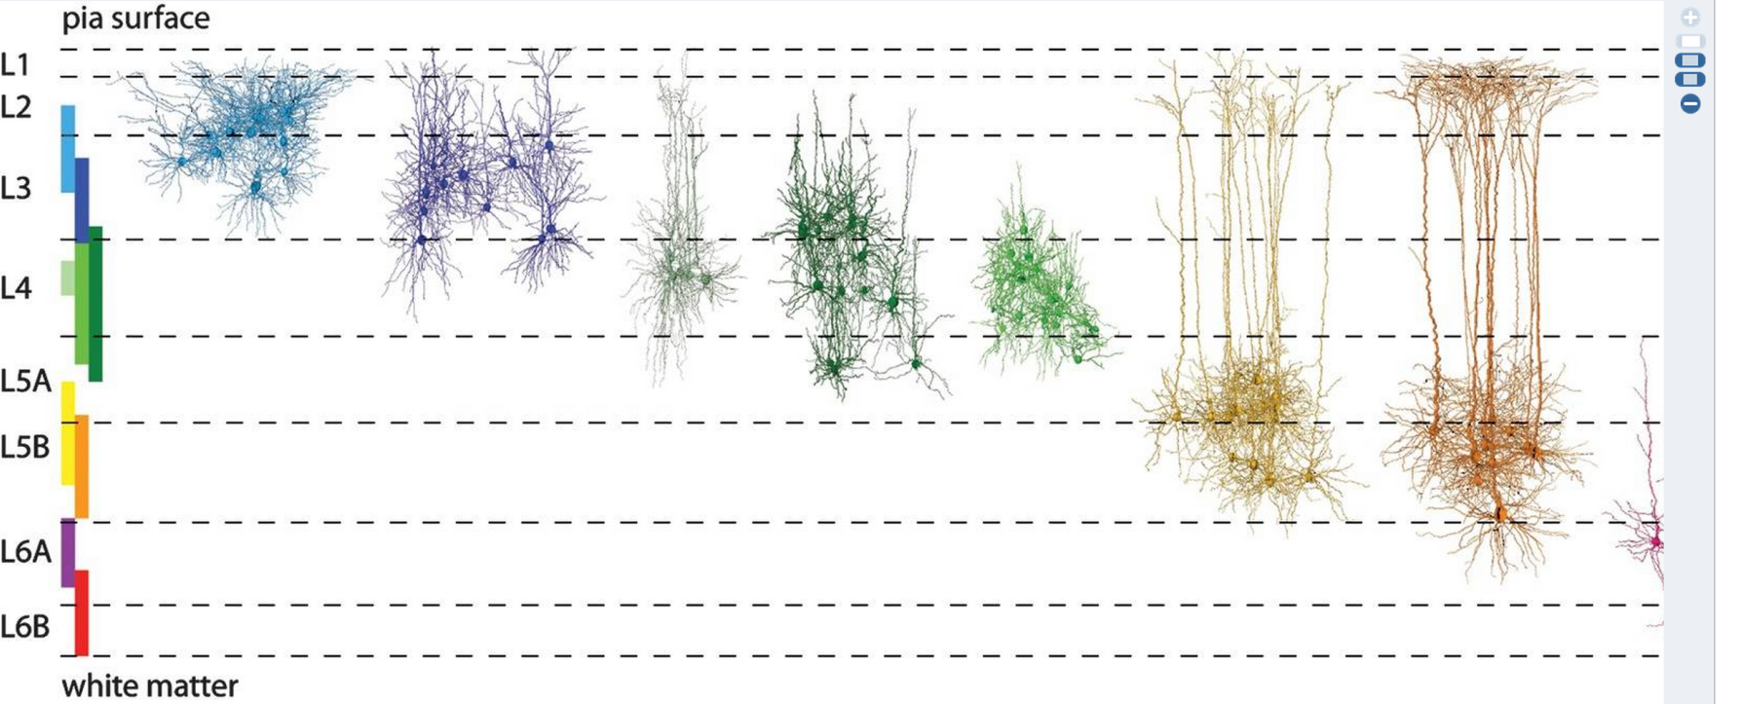
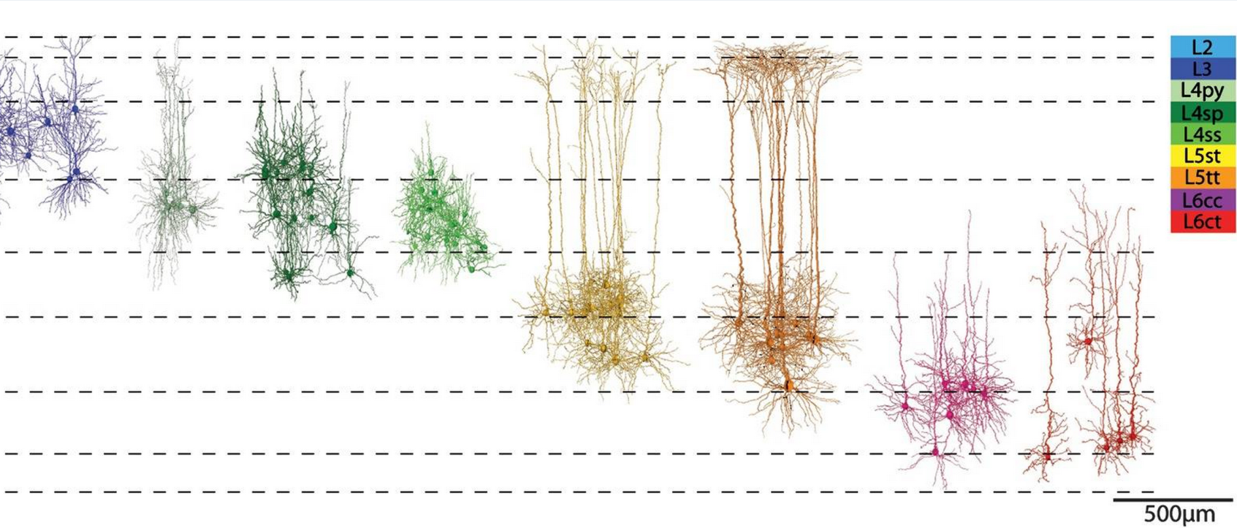
Excitatory cell types across layers (rat S1 cortex)
Canonical models do not capture the diversity of cell classes
Oberlaender et al., Cereb Cortex. Oct 2012; 22(10): 2375–2391.

Slide 13
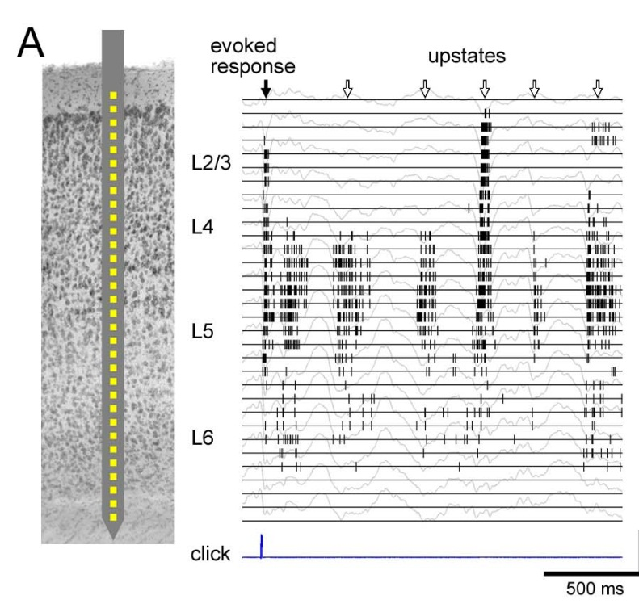
Coding strategies of different cortical layers
Sakata & Harris, Neuron 2010
Canonical models do not capture the diversity of firing rates and selectivities

Slide 14
Why is the cortex layered?
Do different layers have distinct functions?
Is this the right question?

Slide 15
Alternative view:
When thinking about layers, we should really be thinking about cell classes
A cells class may be defined by its input connectome and output projectome (and some other properties)
The job of different classes is to (i) make associations between different types of information available in each cortical column and/or (ii) route/gate different streams of information
Layers are convenient way of organising inputs and outputs of distinct cell classes

Slide 16
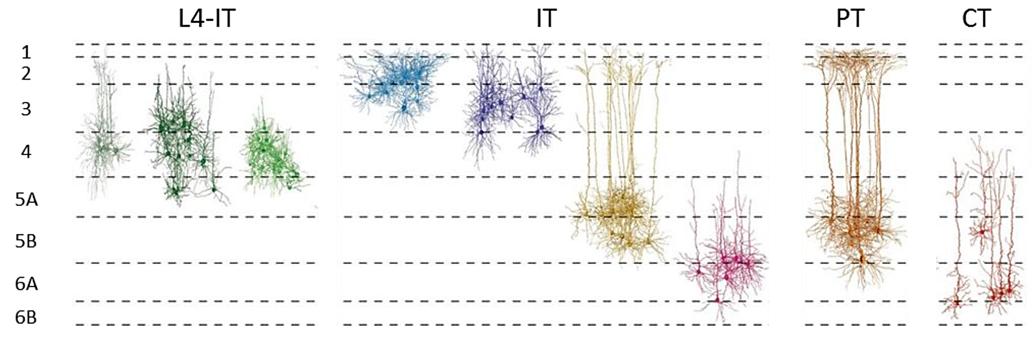
Excitatory cell types across layers (rat S1 cortex)
INTRATELENCEPHALIC (IT) | PYRAMIDAL TRACT (PT) | CORTICOTHALAMIC (CT)
From Cereb Cortex. Oct 2012; 22(10): 2375–2391.
Modified by Harris and Shepherd, 2014

Slide 17

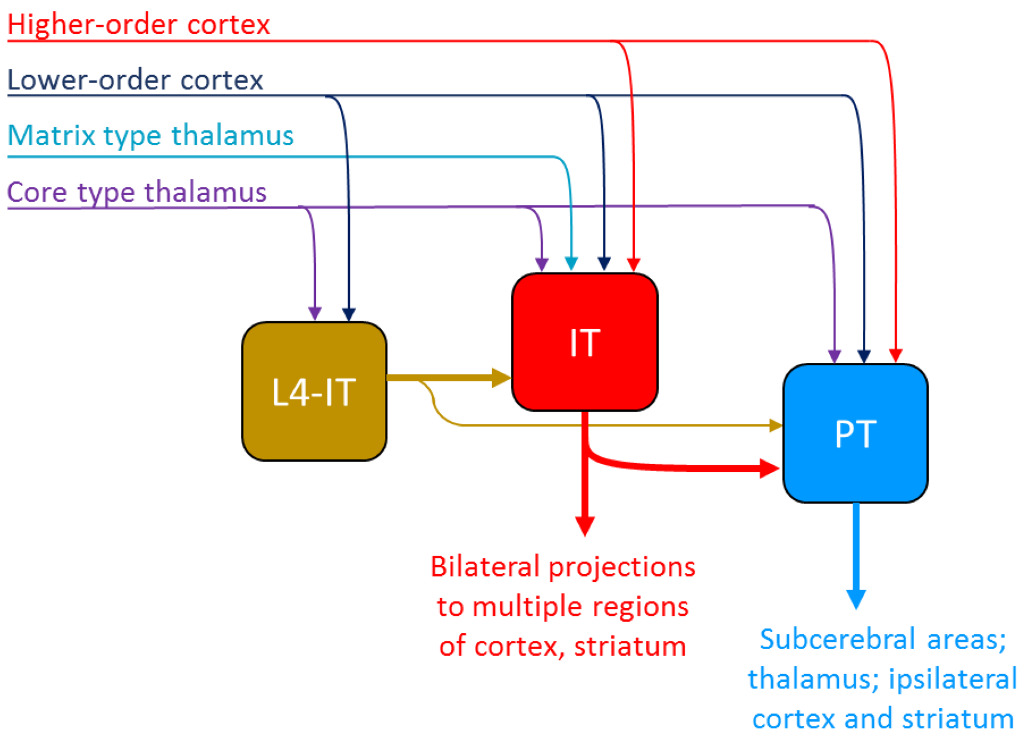
Hodology* of main excitatory cortical classes
* the patterns/rules of connectivity
Harris and Shepherd, 2014, review

Slide 18
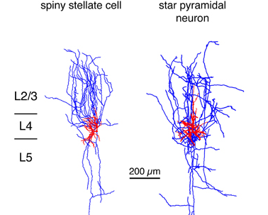
Layer 4
Main input layer
Specialised for each sensory modality
Contains L4 IT neurons that project within a column
Creation of new sensory response properties

Slide 19
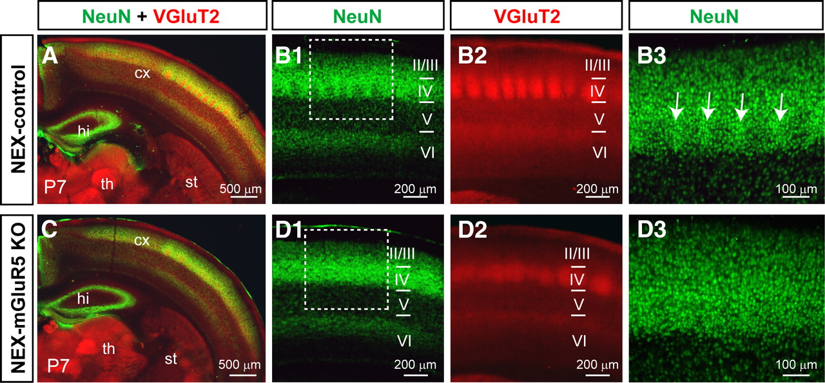
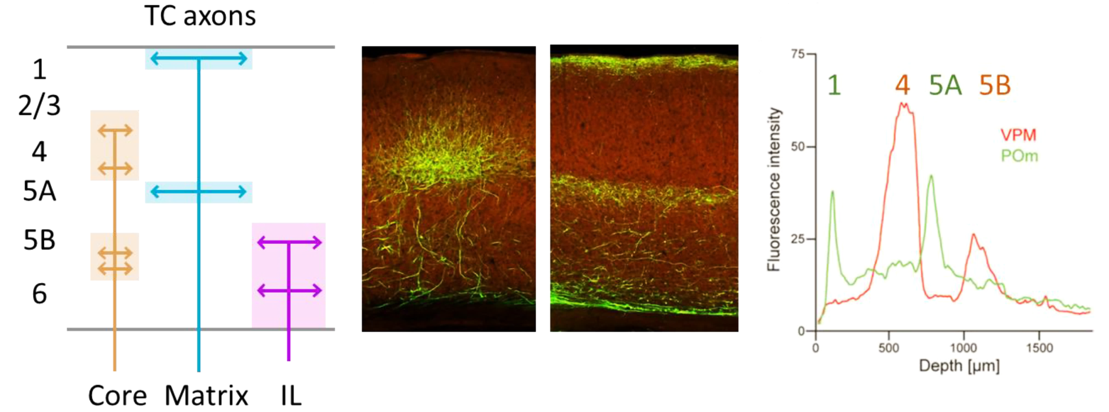
Layer 4: input specialisations
VGLUT2 immunoreactivity (TC axons)
Belester-Rosado et al 2010 J Neurosci

Slide 20
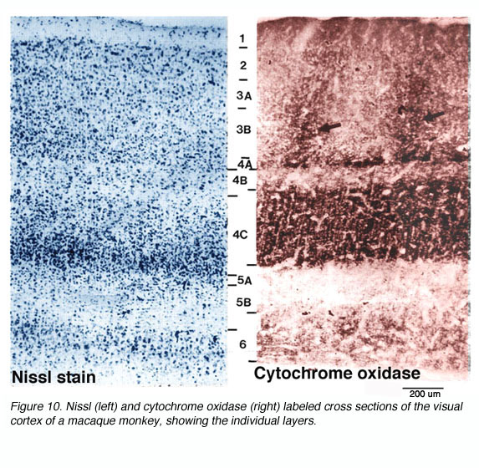
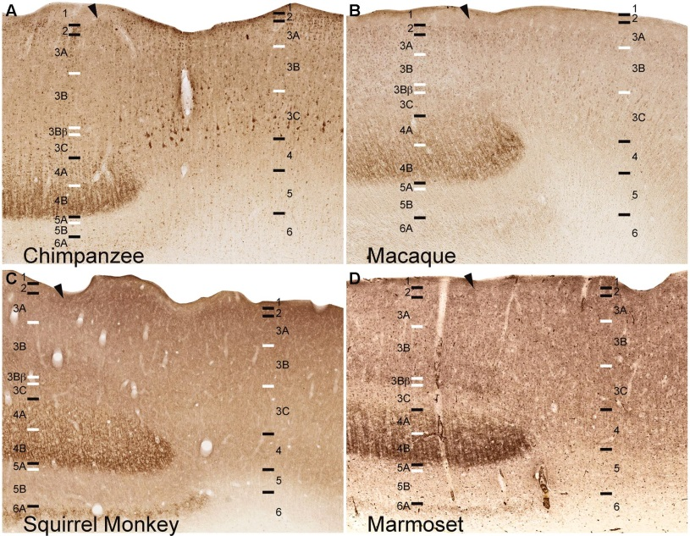
Layer 4: input specialisations
Primary visual cortex
VGLUT2 immunoreactivity (TC axons)
Balaram & Kaas 2014 Front Neuroanat

Slide 21
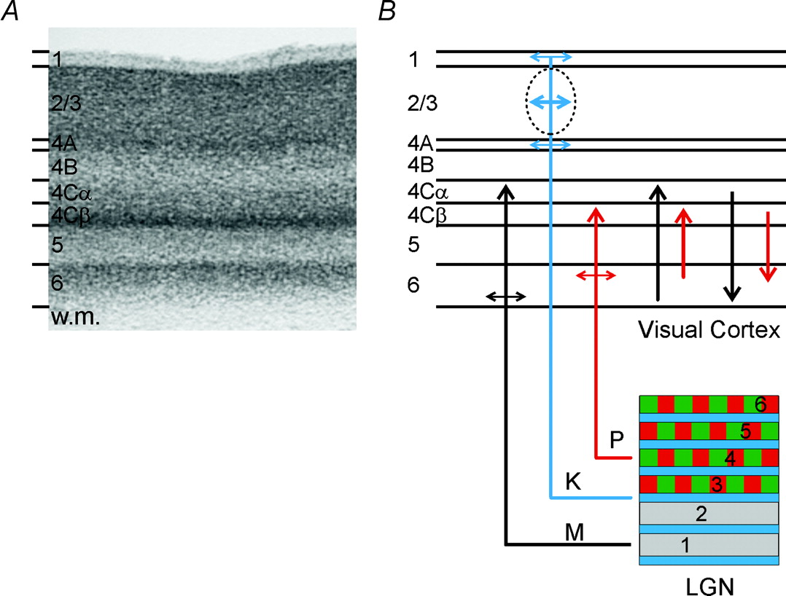
Anatomy of feedforward connections between the LGN and visual cortex (V1)
Nissl-stained section of macaque V1.
Briggs F , and Usrey W M J Physiol 2011;589:33-40
Notes:
Figure 2. Anatomy of feedforward and feedback connections between the LGN and visual cortex (V1) A, Nissl-stained section of V1 from the macaque monkey. Corticogeniculate neurones are located exclusively in layer 6. (w.m., white matter.) B, organization of connections between the LGN and V1. The magnocellular layers of the LGN (1 and 2) are shown in grey, the parvocellular layers (3, 4, 5 and 6) are shown in green and red, the koniocellular layers are located below each of the magnocellular and parvocellular layers and are shown in blue. Magnocellular LGN axons (M) terminate in layers 4Cα and lower layer 6, parvocellular LGN axons (P) terminate in layers 4Cβ and upper layer 6, koniocellular LGN axons (K) terminate in layer 4A, the cytochrome oxidase rich blobs and layer 1. The intrinsic connections in V1 maintain the magno- and parvocellular divisions of layers 4C and 6. Neurones in layer 6 of cortex provide feedback to the LGN. Neurones in the upper third of layer 6 project exclusively to the parvocellular LGN layers. Neurones in the lower third of layer 6 project primarily to the magnocellular layers and perhaps the koniocellular layers.

Slide 22
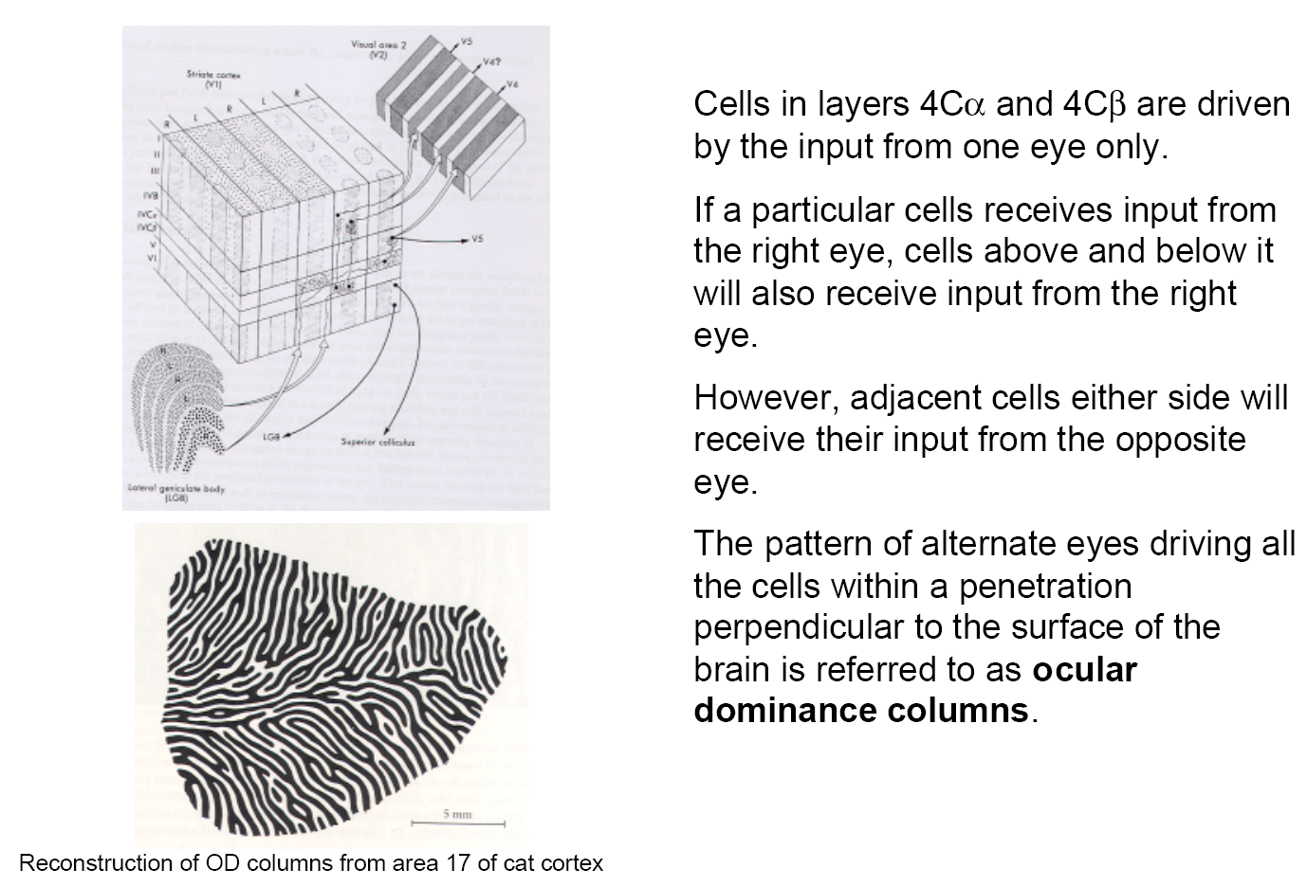
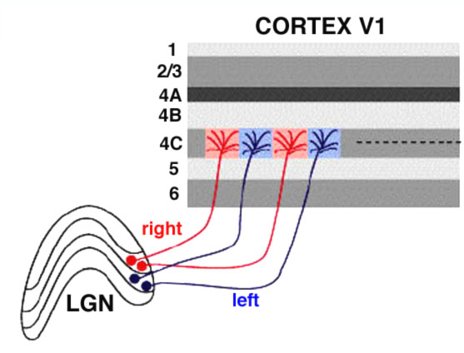
Ocular dominance visual cortex

Slide 23
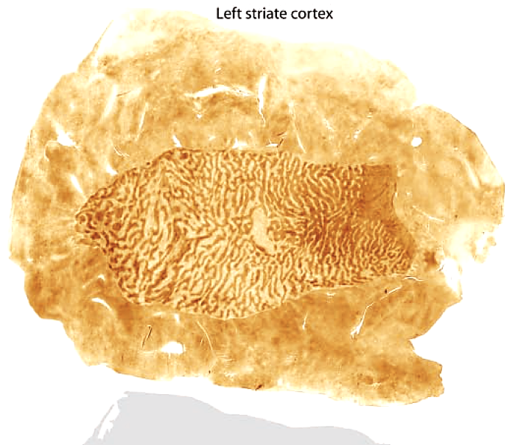
Organisation of ocular dominance in layer 4C in human V1
Cytochrome oxidase staining in layer 4C of human brain
Horton & Adams 2005

Slide 24
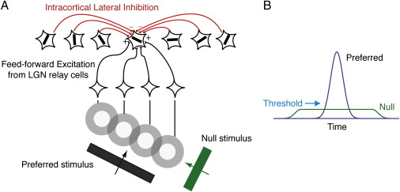
Layer 4
Building new response properties via convergence/selection of TC inputs

Slide 25
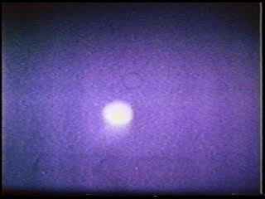

Lateral geniculate nucleus (LGN)
Primary visual cortex (V1)
Orientation-preferring cell
ON cell
Hubel and Wiesel

Slide 26
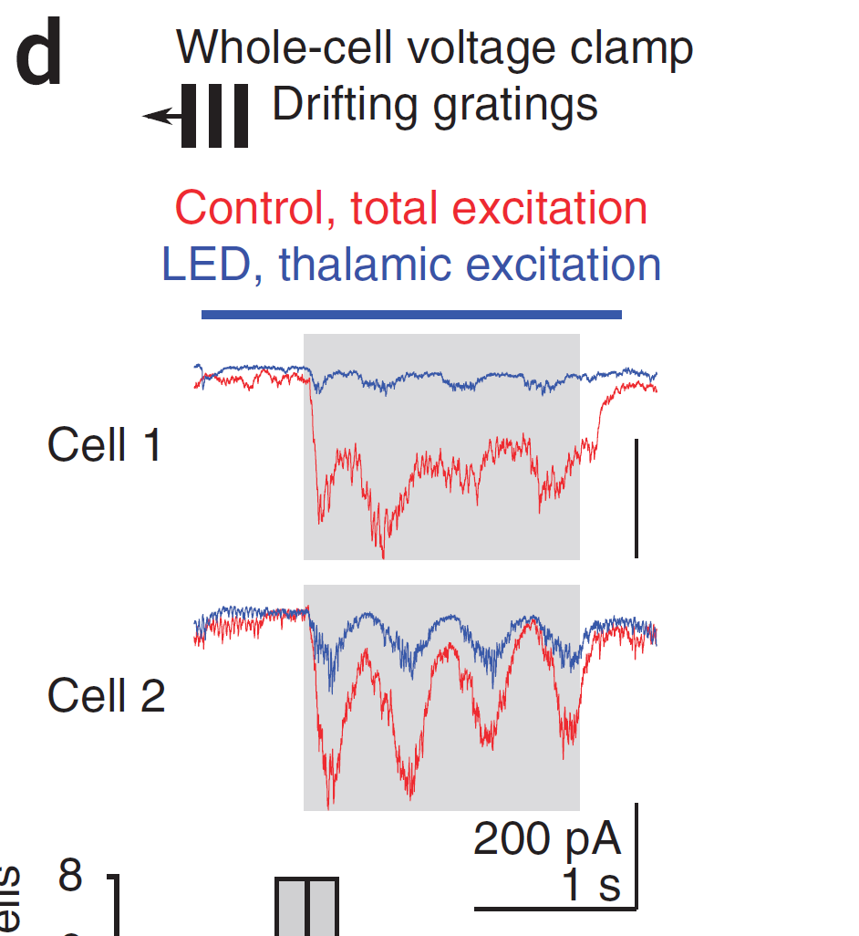
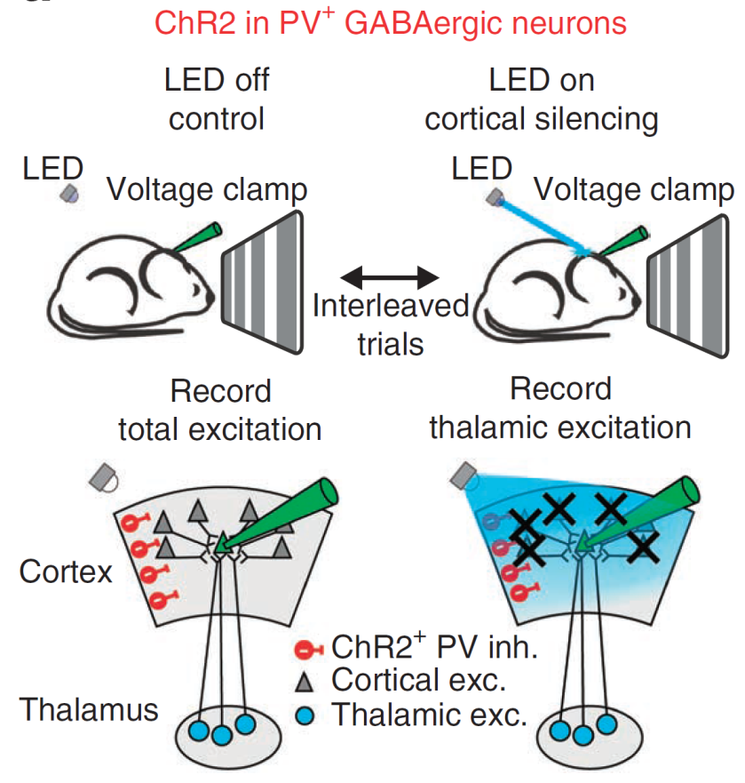
Layer 4
Amplification of sparse and weak sensory input
Lien & Scanziani, 2013

Slide 27
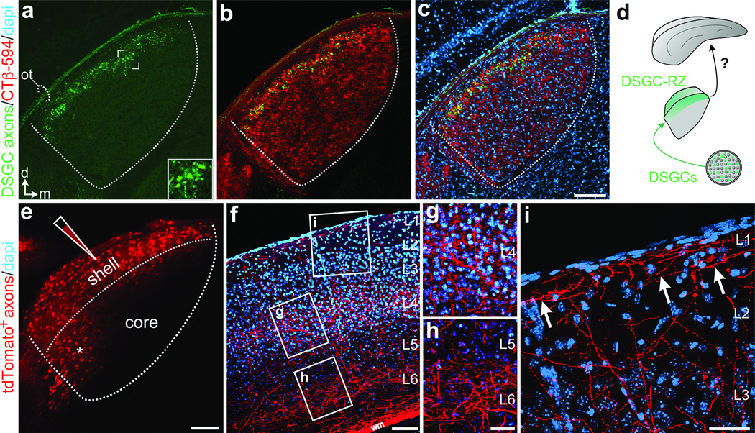
BUT…not all input from the primary thalamus terminates in L4!!
2 examples:
LGN → L1/2/3 of mouse V1
VPN → L5 of mouse S1
Even projections from the primary thalamus can target superficial layers including L1
Cruz-Martin et al., Nature. Mar 20, 2014; 507(7492): 358–361.
Notes:
Figure 2. Anatomy of feedforward and feedback connections between the LGN and visual cortex (V1) A, Nissl-stained section of V1 from the macaque monkey. Corticogeniculate neurones are located exclusively in layer 6. (w.m., white matter.) B, organization of connections between the LGN and V1. The magnocellular layers of the LGN (1 and 2) are shown in grey, the parvocellular layers (3, 4, 5 and 6) are shown in green and red, the koniocellular layers are located below each of the magnocellular and parvocellular layers and are shown in blue. Magnocellular LGN axons (M) terminate in layers 4Cα and lower layer 6, parvocellular LGN axons (P) terminate in layers 4Cβ and upper layer 6, koniocellular LGN axons (K) terminate in layer 4A, the cytochrome oxidase rich blobs and layer 1. The intrinsic connections in V1 maintain the magno- and parvocellular divisions of layers 4C and 6. Neurones in layer 6 of cortex provide feedback to the LGN. Neurones in the upper third of layer 6 project exclusively to the parvocellular LGN layers. Neurones in the lower third of layer 6 project primarily to the magnocellular layers and perhaps the koniocellular layers.

Slide 28
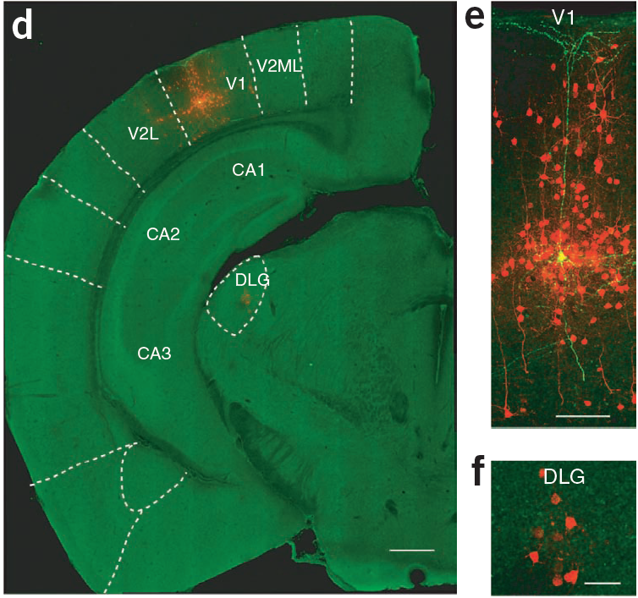
Thalamic inputs to a L5 pyramidal cell in mouse primary visual cortex
Pseudotyped rabies virus tracing
Rancz et al., 2011

Slide 29
BUT…not all input from the primary thalamus terminates in L4!!
2 examples:
LGN → L1/2/3 of mouse V1
VPN → L5 of mouse S1
Pseudotyped rabies virus tracing
Rancz et al., 2011

Slide 30
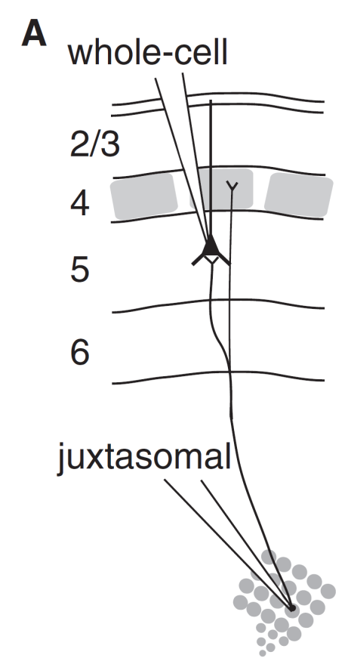
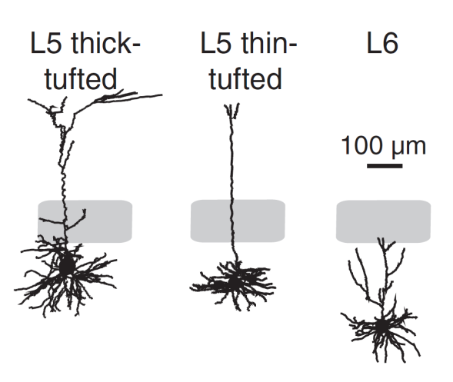
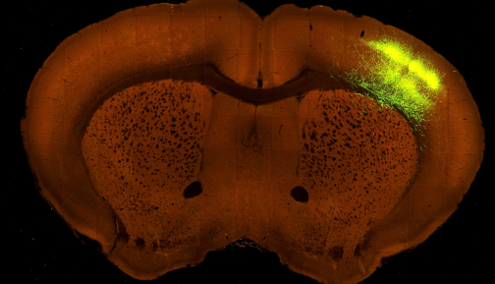
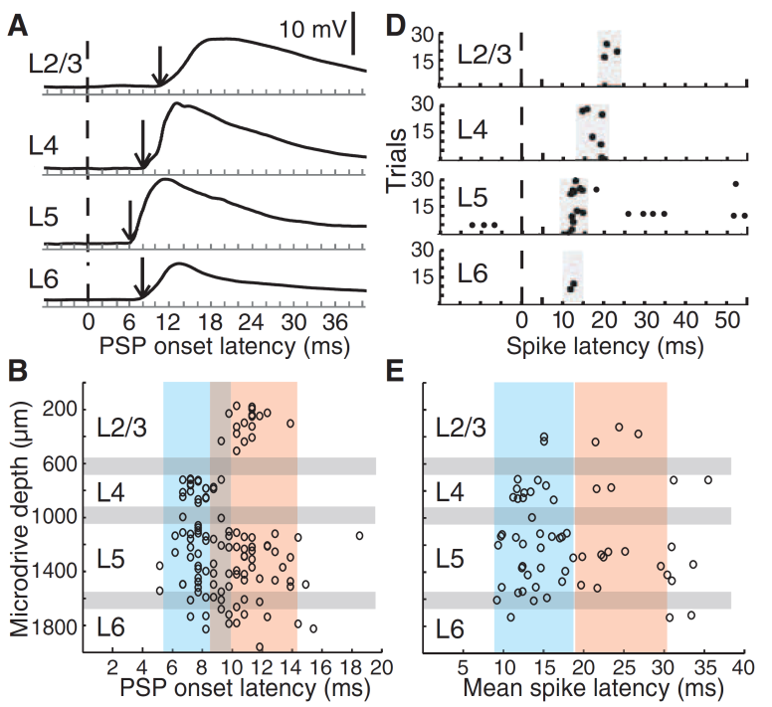

BUT…not all input from the primary thalamus terminates in L4!!
2 examples:
LGN → L1/2/3 of mouse V1
VPN → L5 of mouse S1
Constantinople & Bruno, 2013, Science
Notes:
Figure 2. Anatomy of feedforward and feedback connections between the LGN and visual cortex (V1) A, Nissl-stained section of V1 from the macaque monkey. Corticogeniculate neurones are located exclusively in layer 6. (w.m., white matter.) B, organization of connections between the LGN and V1. The magnocellular layers of the LGN (1 and 2) are shown in grey, the parvocellular layers (3, 4, 5 and 6) are shown in green and red, the koniocellular layers are located below each of the magnocellular and parvocellular layers and are shown in blue. Magnocellular LGN axons (M) terminate in layers 4Cα and lower layer 6, parvocellular LGN axons (P) terminate in layers 4Cβ and upper layer 6, koniocellular LGN axons (K) terminate in layer 4A, the cytochrome oxidase rich blobs and layer 1. The intrinsic connections in V1 maintain the magno- and parvocellular divisions of layers 4C and 6. Neurones in layer 6 of cortex provide feedback to the LGN. Neurones in the upper third of layer 6 project exclusively to the parvocellular LGN layers. Neurones in the lower third of layer 6 project primarily to the magnocellular layers and perhaps the koniocellular layers.

Slide 31
Layer 4
Main input layer
Specialised for each sensory modality only in primary cortex (not a trend across cortex)
Contains L4 IT neurons that project within a column
Creation of new sensory response properties
(e.g. orientation tuning in visual cortex but not always)
Amplification of sparse sensory input
But it is not unique in receiving primary sensory input
Re-coding of peripheral sensory information into a cortical code

Slide 32

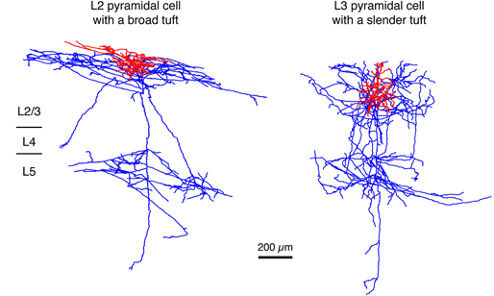
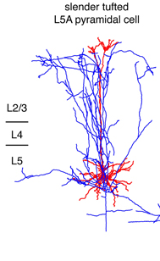
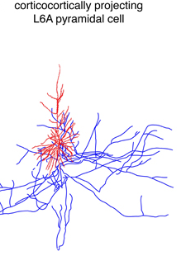
Intratelencephalic (IT) projection neurons
Pyramidal cells (L2/3/5/6)
Extensive local projections

Slide 33
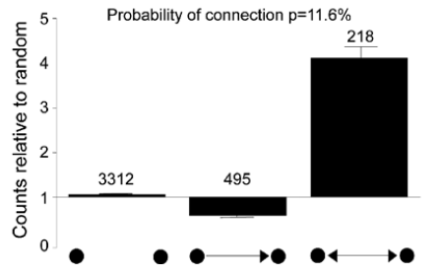
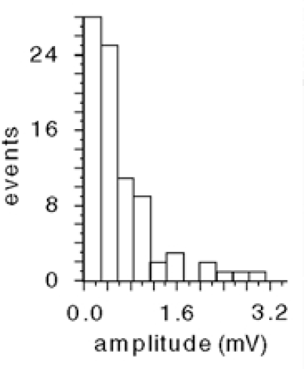
Connectivity of IT cells
Paired-recordings generate statistics of cortical connectivity
Sparse connectivity, skewed connection strength, enrichment of reciprocal connections
Connection probability
Overrepresentation of
bidirectional motifs
Distribution of connection
strengths has a long tail
Lefort et al. 2009
L5 pyramidal cells,
Song et al. 2005
L2/3 pyramidal cells,
Holmgren et al. 2003;

Slide 34
The importance of connection strength
5 APs
5 APs
3.2 mV
0.35 mV
-70 mV
1 mV
150 ms
Notes:
34

Slide 35
How does this organisation relate to sensory function?
weak
strong
Pyramidal cell network (L2/3 or L5)
Identify the rules of connectivity in relation to neural activity
Implications for computations in neocortical circuits
Notes:
1. non-random
so already we must account for these non-random elements
2. important roles in info processing, since two cells which …
so must ask how to distribute these connections
3. describe network
4. But how can we use this to say anything about computation
And whatcan we say abouthow connections influence response..
How do these connections transform inputto output
So although we have described the network to some degree, we still don’t know what connects to what
Key missing element is what the functionof these elements is
Although we can take individual pairs and wire them up probabilisticallyto rules aware of, overall wiring diagram junk comparedto the actual connectivity
Without simultaneous information about how synpatic organization relates to response properties of neurons in network it will be difficult or impossible to understand how local input to cell influences response properties of the neurons.

Slide 36
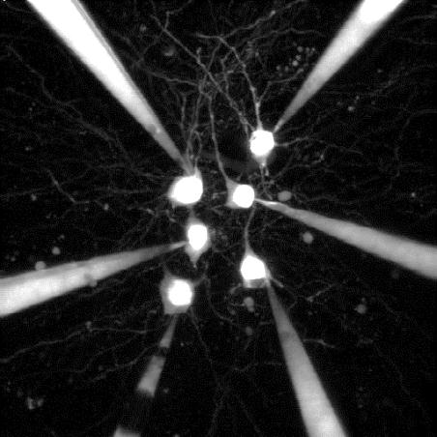
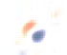
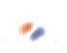


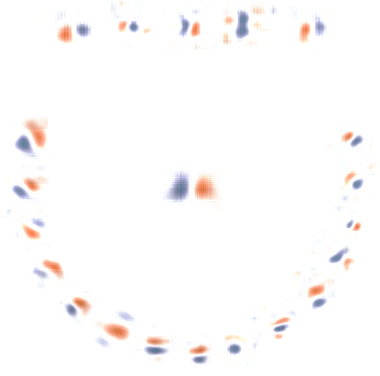
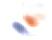





Layer 2 & 3 IT pyramidal cells
Sensory feature specific subnetworks (selective amplification / pattern completion)
Strong
Weak
Layer 2/3 pyramidal cell network

Slide 37






Mapping receptive fields
Two-photon calcium imaging
Reverse correlation
Natural
images
20º
Time
Reverse
correlation
Ca²⁺
signal
Primary visual cortex
Orientation
Spatial frequency
Receptive field size
Receptive field position
ON / OFF subdomain overlap

Slide 38








































































































Receptive field diversity
L2/3
24μm
Example volume V1, Layer 2/3
A measure of receptive field similarity
260μm
M
A
7500
L
P
5000
−0.60
0.62
# pairs
2500
50 μm
0
−0.8
−0.4
0
0.4
0.8
Spatial RF correlation
Cossell, Iacaruso et al 2015

Slide 39
RF similarity predicts probability, strength & reciprocity of synaptic connections
Connection probability
Connection strength
0.7
4
4/6
0.6
3.5
0.5
3
2.5
0.4
EPSP amplitude (mV)
Connection probability
2
0.3
10/32
1/4
1.5
0.2
19/87
1
0.1
7/63
17/128
2/27
15/173
0.5
0
0
-0.8
-0.4
0
0.4
0.8
-0.8
-0.4
0
0.4
0.8
RF correlation
RF correlation
Spatial RF correlation is a strong predictor of connectivity
Cell pairs with positive RF correlations are more likely to connect, with strong connections

Slide 40
RF similarity predicts probability, strength & reciprocity of synaptic connections
Connection probability
Connection strength
Distribution of RF correlations
0.7
4
6
4/6
0.6
3.5
5
0.5
3
2.5
4
0.4
EPSP amplitude (mV)
Connection probability
2
Density function of RF correlations
10/32
3
0.3
1.5
1/4
2
0.2
19/87
1
0.1
7/63
17/128
1
2/27
15/173
0.5
0
0
0
-0.8
-0.4
0
0.4
0.8
-0.8
-0.4
0
0.4
0.8
RF correlation
RF correlation
Spatial RF correlation is a strong predictor of connectivity
Cell pairs with positive RF correlations are more likely to connect, with strong connections

Slide 41
RF similarity predicts probability, strength & reciprocity of synaptic connections
Connection type:
Bidirectional
Unidirectional
0.7
4
6
4/6
0.6
3.5
5
0.5
3
2.5
4
0.4
EPSP amplitude (mV)
Connection probability
2
Density function of RF correlations
10/32
3
0.3
1.5
1/4
2
0.2
19/87
1
0.1
7/63
17/128
1
2/27
15/173
0.5
0
0
0
-0.8
-0.4
0
0.4
0.8
-0.8
-0.4
0
0.4
0.8
RF correlation
RF correlation
Spatial RF correlation is a strong predictor of connectivity
Cell pairs with positive RF correlations are more likely to connect, with strong connections
Reciprocal connections are stronger and exist between cell pairs with similar RFs

Slide 42
Neurons with similar receptive fields make frequent and strong connections
1
6
2
0.7
P = 1.1 × 10⁻⁵
4/6
1.2
5
3
0.6
1.0
4
0.5
0.8
0.4
Connection strength
(EPSP amplitude, mV)
Connection probability
10/32
0.6
0.3
1/4
19/87
0.4
0.2
7/63
17/128
0.1
2/27
15/173
0.2
shuffled
0
0
−0.8
−0.4
0
0.4
0.8
−0.8
−0.4
0
0.4
0.8
Receptive field similarity
Receptive field similarity
Cossell, Iacaruso et al., 2015

Slide 43
Cells that fire together, wire together with strong connections
Signal amplification within subnetworks
weak
strong
Cossell, Iacaruso et al 2015

Slide 44

Connectivity of cortical inhibitory interneurons
SOM
VIP
PV
Excitatory
cell
Inhibitory
cell types

Slide 45
Less selective responses in PV+ interneurons
Znamenskiy et al biorXiv 2019

Slide 46
Different rules of connectivity for excitatory and inhibitory neurons
Znamenskiy et al biorXiv 2019

Slide 47
Different rules of connectivity for excitatory and inhibitory neurons
Sparse, selective connectivity
Dense, less selective connectivity
Excitatory neuron
PV interneuron
Selective response
Less selective response
Firing rate
Firing rate
0º 90º 180º
0º 90º 180º
Stimulus orientation
Stimulus orientation
from Harris & Mrsic-Flogel, 2013

Slide 48

Response similarity predicts the strength of PV→Pyr connections
Pyr
PV
PV
Pyr
Response similarity
Response similarity
Znamenskiy et al biorXiv 2019

Slide 49
Modelling different E-I networks
Znamenskiy et al biorXiv 2019

Slide 50
Simulated stimulation in the model
Znamenskiy et al biorXiv 2019

Slide 51
Marshel et al 2019 Science

Slide 52
Marshel et al 2019 Science

Slide 53
Marshel et al 2019 Science

Slide 54
Sparse coding in L2/3 (and L5) IT cells
Spontaneous activity
Sakata & Harris, Neuron 2010

Slide 55
History of correlated firing is embedded in the structure of network connectivity (priors)
Consequences
Strong excitation within subnetworks is balanced by strong reciprocal inhibition
Selective and stable amplification of input within subnetworks
Decorrelation between subnetworks (‘pattern separation’)
Weights are plastic and adjusted by experience

Slide 56



Layer 2 & 3 IT PCs: Contextual Interactions and Surround Inhibition
Whole-cell recordings form L2/3 IT pyramidal cells
Strong lateral/surround inhibition
Adesnik &Scanziani 2010 Nature

Slide 57
Layer 2 & 3: Contextual Interactions and Surround Inhibition
Whole-cell recordings form L2/3 IT pyramidal cells
Strong lateral/surround inhibition
Pecka et al., 2014, Neuron

Slide 58


Somatostatin-positive interneurons (SOM or SST)
L 2/3 SOM cells may play a role in surround suppression (as might PV cells…)
Adesnik et al., 2013, Nature

Slide 59
Layer 2 & 3: Contextual Interactions and Surround Inhibition
Surround suppression changes selectivity and depends on context
Pecka et al., 2014, Neuron

Slide 60
Sparse coding in L2/3 (and L5) IT cells
Spontaneous activity
Sakata & Harris, Neuron 2010

Slide 61


Intratelencephalic (IT) projection neurons
Pyramidal cells (L2/3/5/6)
Intrahemispheric, striatal and callosal projections
Suarez and Richards, 2014 Neuron
Long-Range Focal Collateralization of Axons Arising from Corticocortical Cells in Monkey Sensory-Motor Cortex
DeFelipe & Jones, 1986, JN

Slide 62

From the Allen Institute for Brain Research

Slide 63


IT cells

Slide 64


How many classes of IT projection neurons?
From Nassi & Callaway
Adapted from Harris and Shepherd, 2014, review

Slide 65

How many classes of IT projection neurons?
From Nassi & Callaway
Yamashita & Petersen, Neuron, 2013
Adapted from Harris and Shepherd, 2014, review

Slide 66



Case study: How many types of IT projection neurons are there in V1?
striatum
thalamus
superior colliculus
other subcortical
http://connectivity.brain-map.org/

Slide 67
Understanding the logic of cortical projections
How many projection classes?
V1 projection
neuron
Target
area
Type 1
Type 2
Type 3
Type 4
striatum
thalamus
superior colliculus
other subcortical
Type 5

Slide 68




Example L2/3 projective fields

Slide 69




The majority of neurons project to multiple targets

Slide 70
Layer 2 & 3 IT pyramidal cells
pyramidal cells and most interneuron types
Project strongly primarily to L5 and to other cortical areas (also striatum)
Highly diverse projections of individual neurons
Sensory feature specific subnetworks (selective amplification/pattern completion)
Contextual integration of information across the same sensory modality
Strong lateral/surround inhibition
Sparse coding

Slide 71
How does the local connectivity of IT cells
relate to their long-range targets?

Slide 72





AL and PM projecting neurons are largely non-overlapping populations
PM
Intrinsic imaging of visual areas
V1
AM
AL
AL
PM
V1
LM
1 mm
1 mm
Retrograde tracing
L2/3
L5
AL 19%,
PM 14%
DL 0.5%
AL 15%,
PM 18%
DL 2%
Meanhwan Kim

Slide 73
Local connectivity of L2/3 projection neurons is target-specific
CTB-594
CTB-488
PM
V1
AL
Layer 2/3
**
25/114
*
0.2
8/46
36/250
Connection probability
0.1
2/45
1/45
0
total
AL AL
AL PM
PM AL
PM PM
Kim*, Znamenskiy* 2018 Neuron

Slide 74

Higher visual areas AL and PM are functionally different
Temporal frequency
Spatial frequency
1 mm
Wang and Burkhalter, 2007
GCaMP in V1, image boutons in AL or PM
Inputs in PM
Inputs in AL
Glickfeld et al., 2013

Slide 75

Layer 5: PT cells
Pyramidal cells (subcerebral projections neurons, e.g. brainstem, superior colliculus)
Typically project to motor-related structures, and ipsilateral cortex, striatum, thalamus, but not contralateral cortex
Kita and Kita, 2012, JN

Slide 76

Layer 5: PT cells
Kita and Kita, 2012, JN

Slide 77

Coding strategies of different cortical layers
Spontaneous activity
Sakata & Harris, Neuron 2010
De Kock et al, 2007

Slide 78

IT versus PTs neurons: Firing rate differences
Cereb Cortex. Oct 2012; 22(10): 2375–2391.

Slide 79

IT versus PTs neurons: Local connectivity differences
Brown & Hestrin 2009 Nature

Slide 80
Layer 5: PT cells
Pyramidal cells
Typically project to motor-related structures, and ipsilateral cortex, striatum, thalamus, but not contralateral cortex
High firing rates, non-adapting, sometimes bursting
PT cells integrate cortical and TC inputs and broadcast them to subcerebral structures

Slide 81
What happens in Layer 1?
Very few cell bodies
Dendrites of pyramidal cells whose somata reside in layers 2-6.
Only a few Interneurons (mostly 5HT3R positive neurogliaform cells)
But axons of other interneurons (VIP, SST, PV)
Many cortical and thalamic long-range inputs
Main site of association in the cortex
integration of feedforward and feedback/top-down inputs

Slide 82

What kind of inputs innervate L1?
Thalamocortical (higher-order/matrix thalamus)
→ Contextual information within the same sensory modality
Larkum, 2013, TINS
Laminar profile of thalamocortical (TC) input types
Harris and Shepherd, 2014, review, unpublished

Slide 83



What kind of inputs innervate L1?
Thalamocortical (higher-order/matrix thalamus)
→ Contextual information within the same sensory modality
Corticocortical
→ contextual information from the same or different modalities
Larkum, 2013, TINS
Cruikshank et al., 2012 JN
Zingg et al 2014 Cell

Slide 84




Case study: response modulation by dendritic plateau potentials
in barrel cortex during active sensation
Long-range Input from vM1 to layer 1 of vS1
L5 pyr cell tufts exhibit calcium touch-related plateau potentials, dependent on vM1 input
Lee & Rudy 2013 Nat Neurosci; Xu & Magee 2012, Nature

Slide 85




VIP interneurons receive strongest input from vM1
SST neurons suppressed by whisking and touch
VIP interneurons most strongly inhibit SST interneurons that inhibit pyr cell dendrites
→ Disinhibition of pyramidal cell dendrites
Gentet et al., 2013, Nat Neurosci
Chr2 in VIP cells
Pi et al., 2013, Nature
Inhibitory (VIP) interneuron control of the influence of long-range signals
→ role in active sensing

Slide 86

Constantinople & Bruno, 2013, Science
Larkum, 2013, TINS

Slide 87

VIP-positive interneurons
VIP cells mostly inhibit SOM cells (barrel cortex) -> Disinhibition of pyramidal cells
Lee et al., 2013, Nature Neurosci

Slide 88


The mysterious layer 6
at least two classes of projection neuron
- IT and CT
in mouse V1, CTs receive more input from higher order cortical areas
CT only cell class that projects to reticular nucleus of the thalamus (RTN) and the core thalamus
intracolumnar inhibition?
Velez-Fort et al., 2014 Neuron

Slide 89

In mouse V1, CTs receive more input from higher order cortical areas
Velez-Fort et al., 2014 Neuron

Slide 90

In mouse V1, L6 CTs mediate intracolumnar inhibition
Olsen et al, 2012 Nature

Slide 91


L6 intracolumnar inhibition mediated by L6 interneurons projecting to all layers
Bortone et al, 2014 Neuron

Slide 92
Open questions
How many cell classes and subclasses?
Genetic versus activity dependent determinism?
What does L2/3 actually do?
Do different L1 inputs target different cell types?

Slide 93
The function of any neuron in the network can be defined by:
Type of input it receives (what it fires to)
Susceptibility to neuromodulators (how its firing is modulated by brain state and reinforcement signals)
Transmitter type (effect on target neurons; excitatory vs inhibitory)
Intrinsic properties and amount of inhibition received (how it fires; dense vs sparse; adapting vs non-adapting; bursty vs regular)
Projective field, defined by the pattern of its axonal arborisation (whom it drives)
Cortical layering is just a convenient way of organising inputs and outputs of different cell classes

Slide 95
These parameters may be used to break down neural diversity into “cell classes” (if you care about categorisation).
This knowledge might tells us something about why a brain region is organised in a particular way, with respect to its structure and function.
The job of different excitatory cell classes is to make associations between different types of information available in each cortical column
Inhibitory cell classes normalise & stabilise activity, and gate information flow in a state dependent manner.
Layers are convenient way of organising inputs and outputs of distinct cell classes
In general, computational models of circuits do not capture the diversity of excitatory and inhibitory cell classes. More dialogue between computational and experimental neuroscientists, please!

Slide 96


Putative hodology of main excitatory cell classes
Harris and Shepherd, 2014, review,

Slide 97
 | IT | IT | PT | CT
 | L4 | Other layers
Genes | Rorb, Satb2 | Satb2 | Fezf2, Ctip2 | Tbr1
Inputs from local E cell classes | Few | Many, incl. L4 IT and other IT. | Many, mainly from IT | Few, mainly deep-layer (L5B/6) IT
Outputs to other local cell classes | Mainly IT, mainly L3. Sometimes PT. | IT (but not L4-IT), PT, CT | Few | Some interconnectivity with IT, possibly PT
Long-range inputs | Thalamus, lower-order cortex | Thlalamus, higher and lower-order cortex | Thalamus, higher and lower-order cortex | Higher order cortex
Long-range outputs | Few | Many, but only within telencephalon (neocortex, striatum); the only ECs sending callosal/commisural projections | Many, to multiple subcortical and subcerebral regions (brainstem, tectum, spinal cord, thalamus, basal ganglia) | Thalamus. The only ECs to excite reticular nucleus. The only ECs without longer-range corticocortical axons.
Morphology/Layers | L4 pyramidal/stellate | L2/3, 5A, 5B, 6; pyramidal | L5B, thick tufted pyramidal | L6, pyramidal
Intrinsic physiology | Regular spiking or bursting | Hyperpolarized (L2/3), little h-current, spike train adaption | Depolarized, strong h-current, little adaptation, bursting (subset) | Regular spiking
In vivo activity | Fast sensory response | Sparse firing/code | Dense code | Very sparse
IT: intratelencephalic neurons; PT: pyramidal tract neurons of L5B; CT: corticothalamic neurons of L6.

